Slide 1
Ready to Practice The Phases of Mitosis?

Slide 2
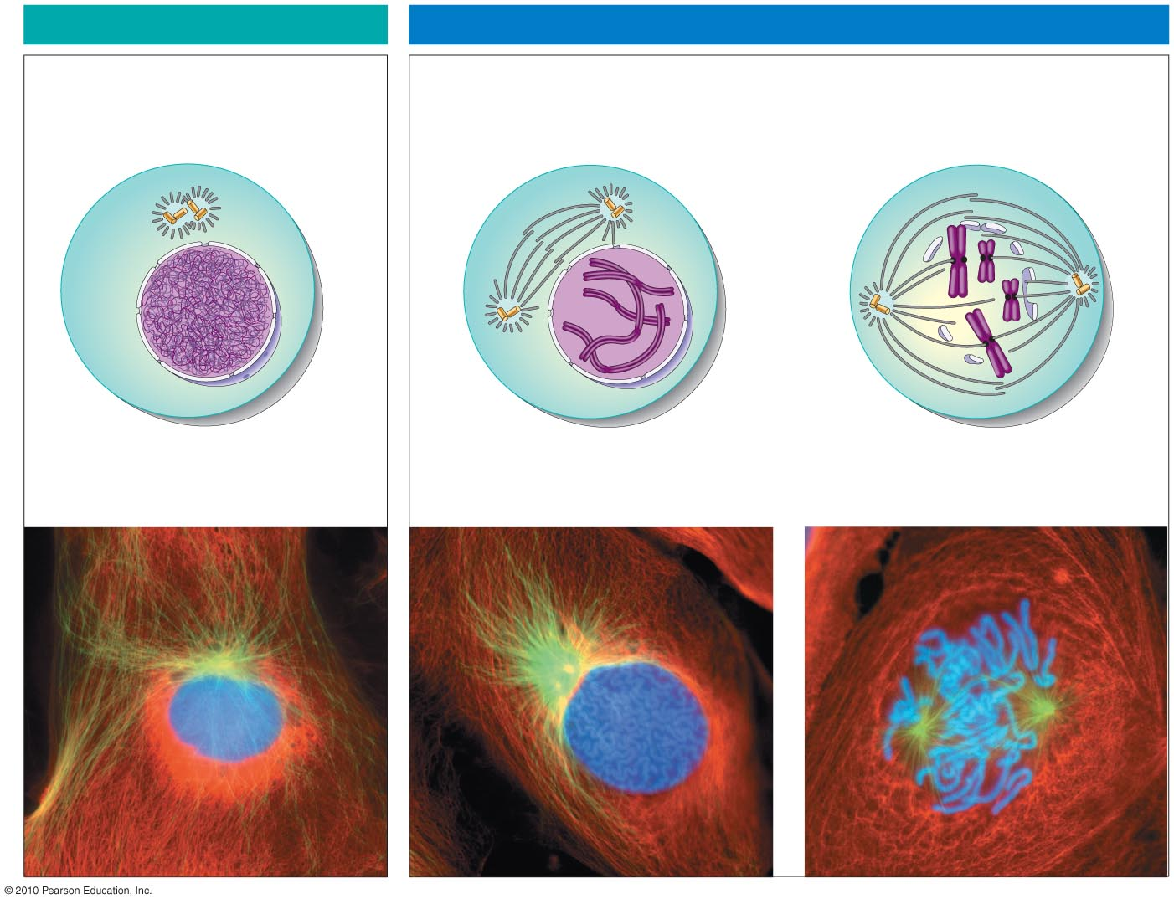
INTERPHASE
PROPHASE
Centrosomes
(with centriole pairs)
Early mitotic
spindle
Fragments of
nuclear envelope
Centrosome
Chromatin
Centromere
Nuclear
envelope
Plasma
membrane
Chromosome, consisting
of two sister chromatids
Spindle
microtubules
LM
Figure 8.7.a
Notes:
Figure 8.7a Cell reproduction: A dance of the chromosomes. (Part 1)

Slide 3
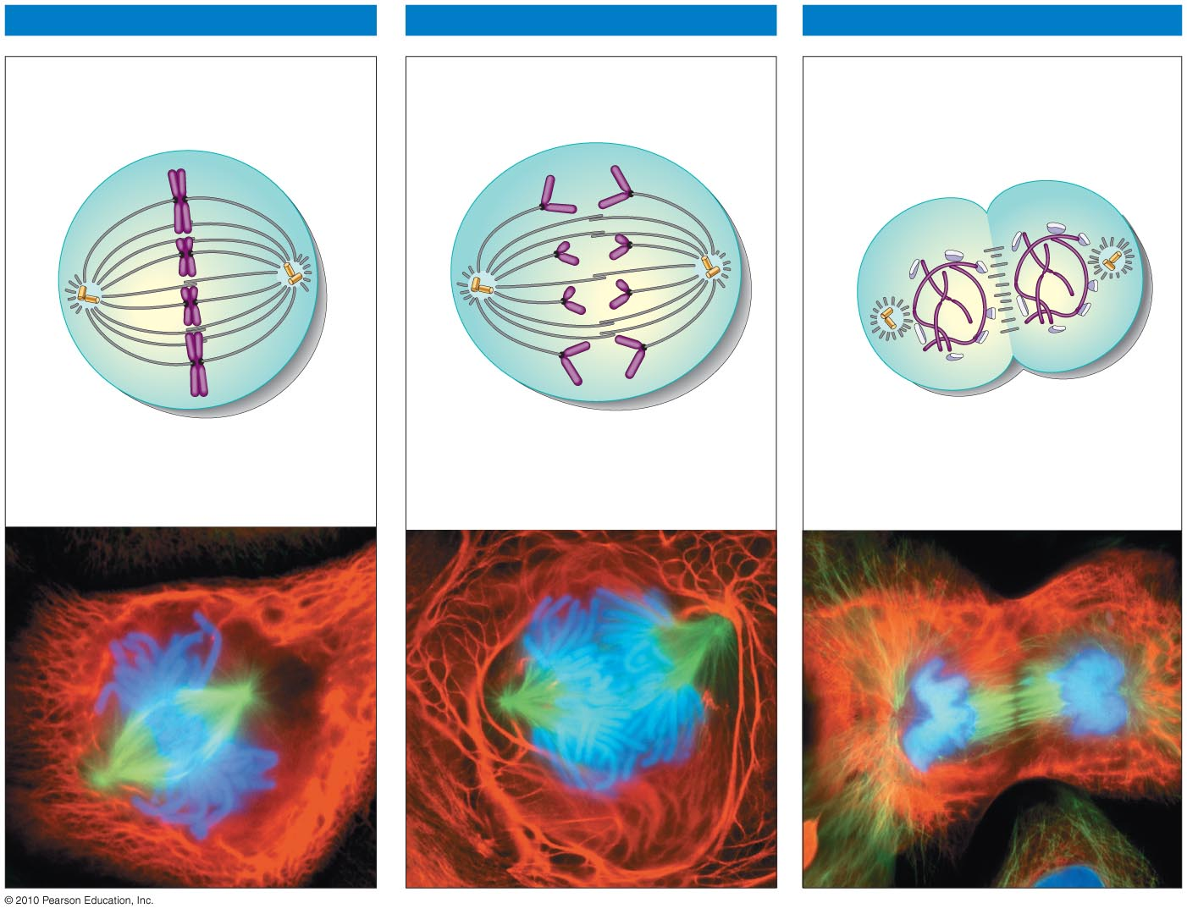
METAPHASE
ANAPHASE
TELOPHASE AND CYTOKINESIS
Nuclear
envelope
forming
Cleavage
furrow
Spindle
Daughter
chromosomes
Figure 8.7b
Notes:
Figure 8.7b Cell reproduction: A dance of the chromosomes. (Part 2)

Slide 4
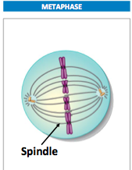
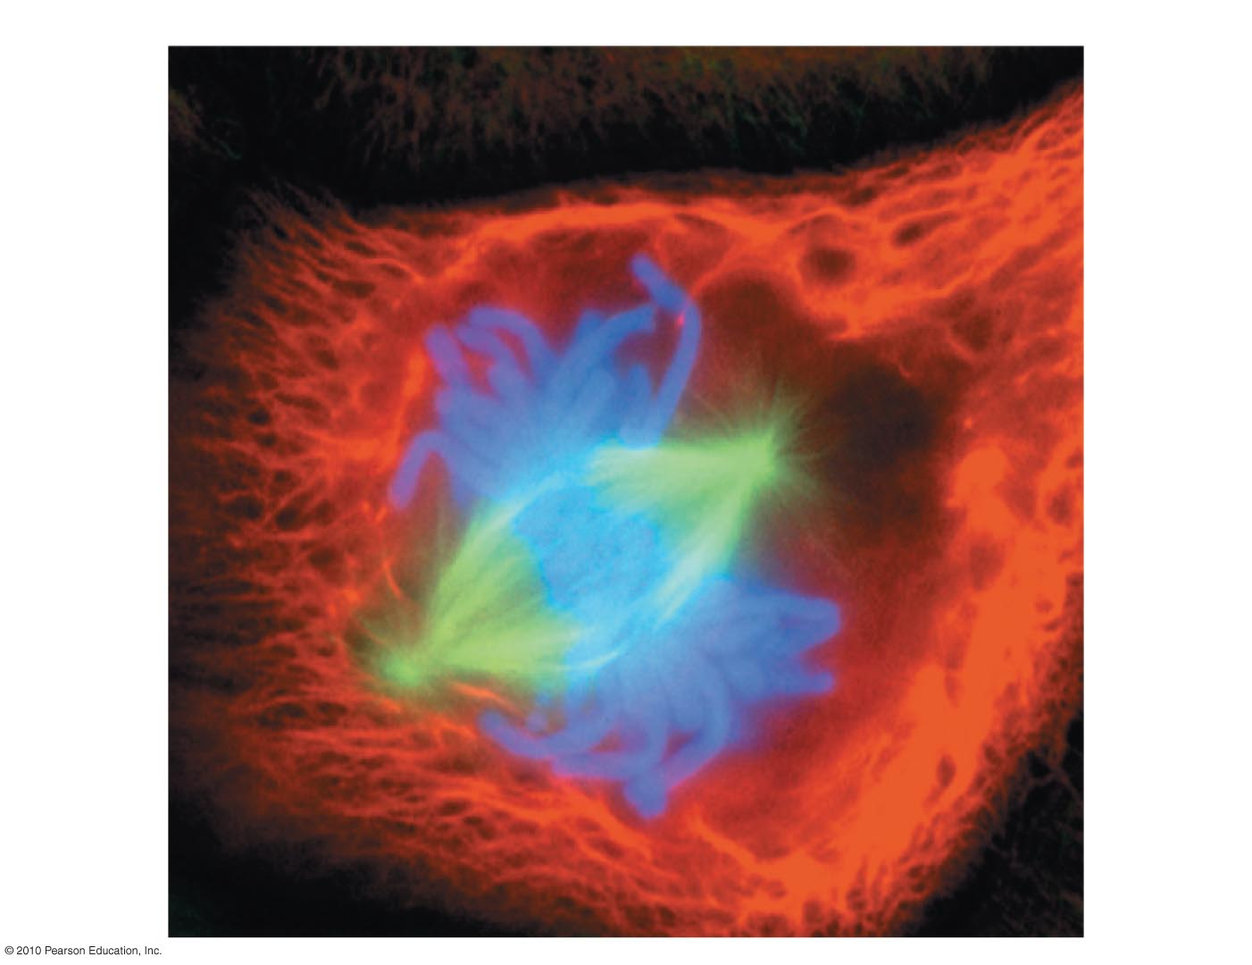
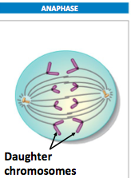
Practice Exam Question
METAPHASE
Figure 8.7bb
Notes:
Figure 8.7bb Cell reproduction: A dance of the chromosomes. (Part 2)

Slide 5
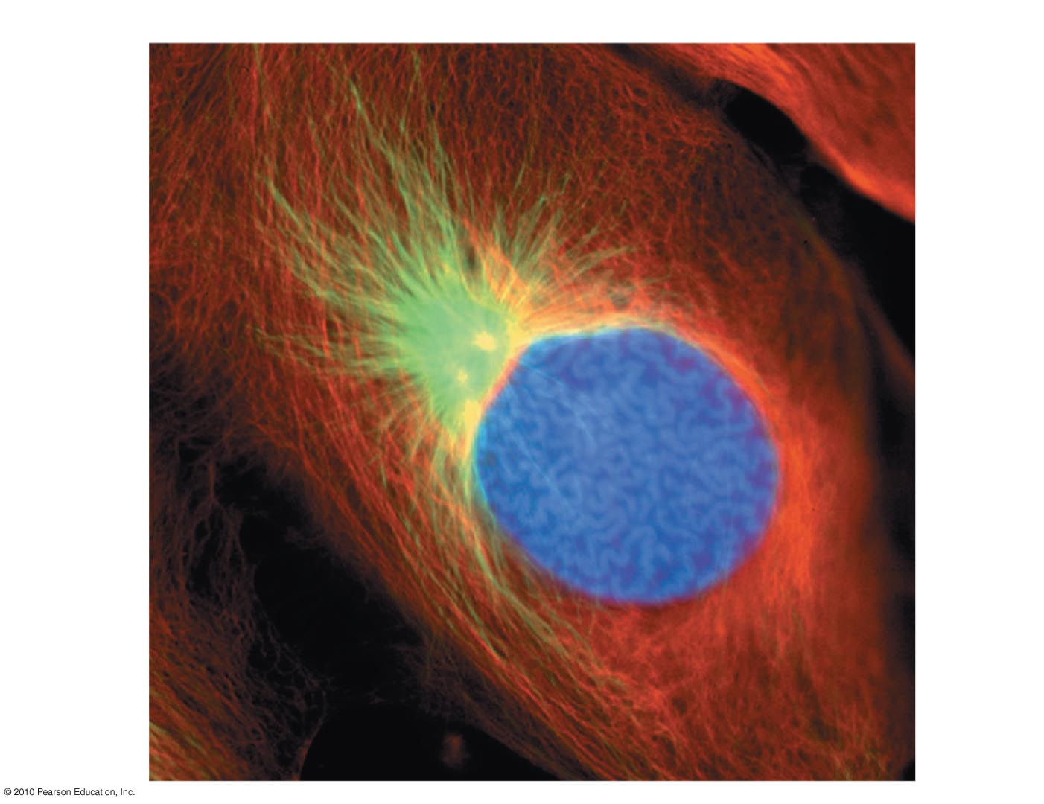
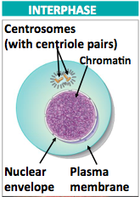
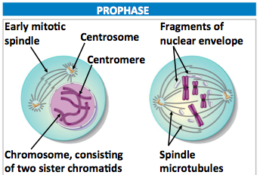
Practice Exam Question
PROPHASE
LM
Figure 8.7.ac
Notes:
Figure 8.7ac Cell reproduction: A dance of the chromosomes. (Part 1)

Slide 6
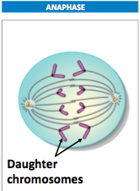
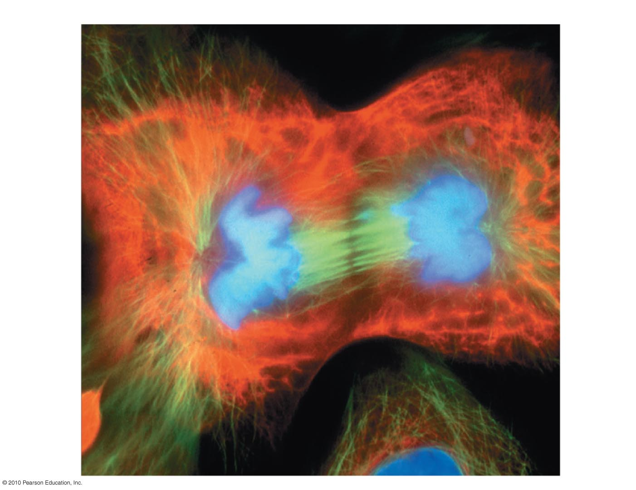
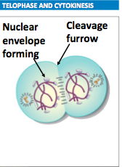
Practice Exam Question
TELOPHASE AND CYTOKINESIS
Figure 8.7bd
Notes:
Figure 8.7bd Cell reproduction: A dance of the chromosomes. (Part 2)

Slide 7
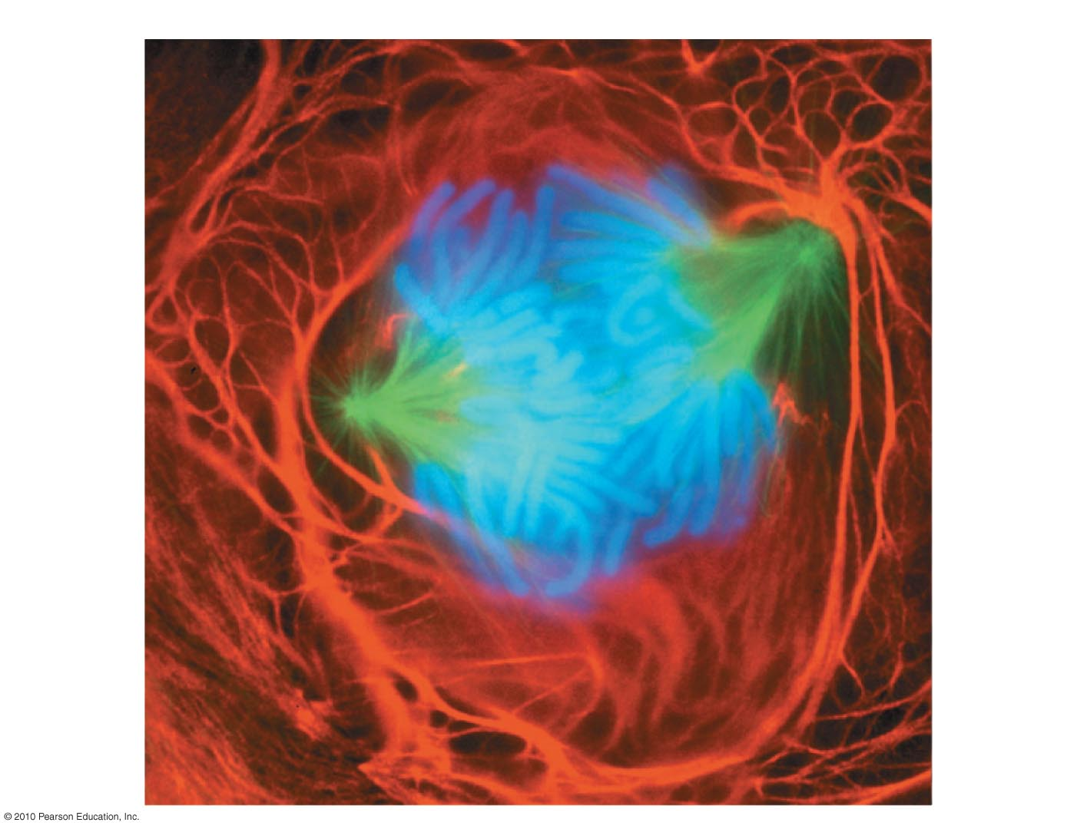
Practice Exam Question
ANAPHASE
Figure 8.7bc
Notes:
Figure 8.7bc Cell reproduction: A dance of the chromosomes. (Part 2)

Slide 8
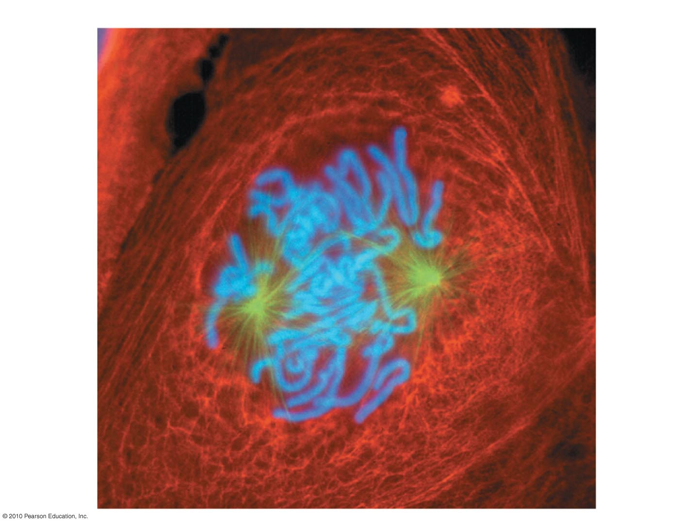
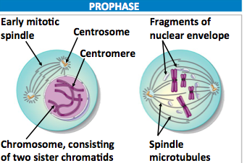
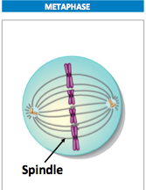
Practice Exam Question
PROPHASE
LM
Figure 8.7.ad
Notes:
Figure 8.7ad Cell reproduction: A dance of the chromosomes. (Part 1)

